Slide 1

Detection of Alzheimer’s disease using Deep Learning
Siddhii Bothraa (101606)
Jonathan Jackson (101618)
Shruti Telang (101657)

Slide 2


Roadmap
Abstract
Introduction
Literature Survey
Existing Systems
Proposed System
Design
Image Preprocessing
Dataset
CNN Architecture
Conclusion & Future Scope
References

Slide 3
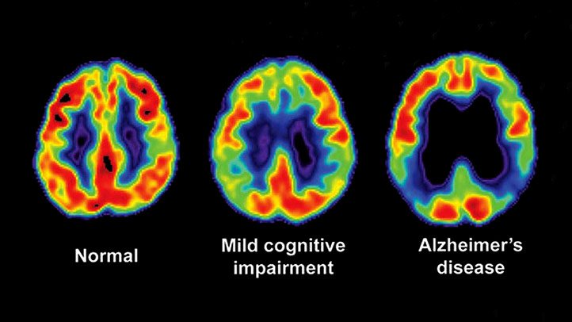
Abstract
Senile Dementia
Memory loss and cognitive decline
Drugs are effective in early stage of the disease
Evaluate an efficient pre-detection method

Slide 4
Problem Statement
An application that detects the presence of Alzheimer’s Disease from the brain MRI scan of a patient. MRI scan of a patient will be uploaded by the doctor. The system will give predictions based on the the classified MRI scan and a small examination aka-questionnaire filled by the patient. The system will also be facilitated by a doctor verification option (only if required).

Slide 5

Motivation
Deep Learning concerned structure and function of the brain
Way to provide medical help with AD
Reduce burden on an individual (psychologically & financially)
Contribute towards slowing down decline of memory and other cognitive skills
Notes:
Deep learning is concerned with machine learning which is inspired by the structure and function of the brain

Slide 6
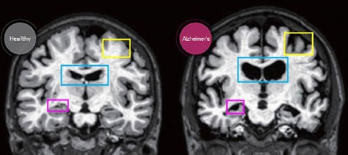
Introduction
Neurodegenerative Dementia
Mostly found in people of age above 60
Damages Brain cells
Memory loss and cognitive denial
Caused by concussions or traumatic events
MRI view of healthy brain(left) and an Alzheimer’s brain(right)
(Yellow-Cortex, Blue-Ventricle, Purple-Hippocampus volume reduced)

Slide 7

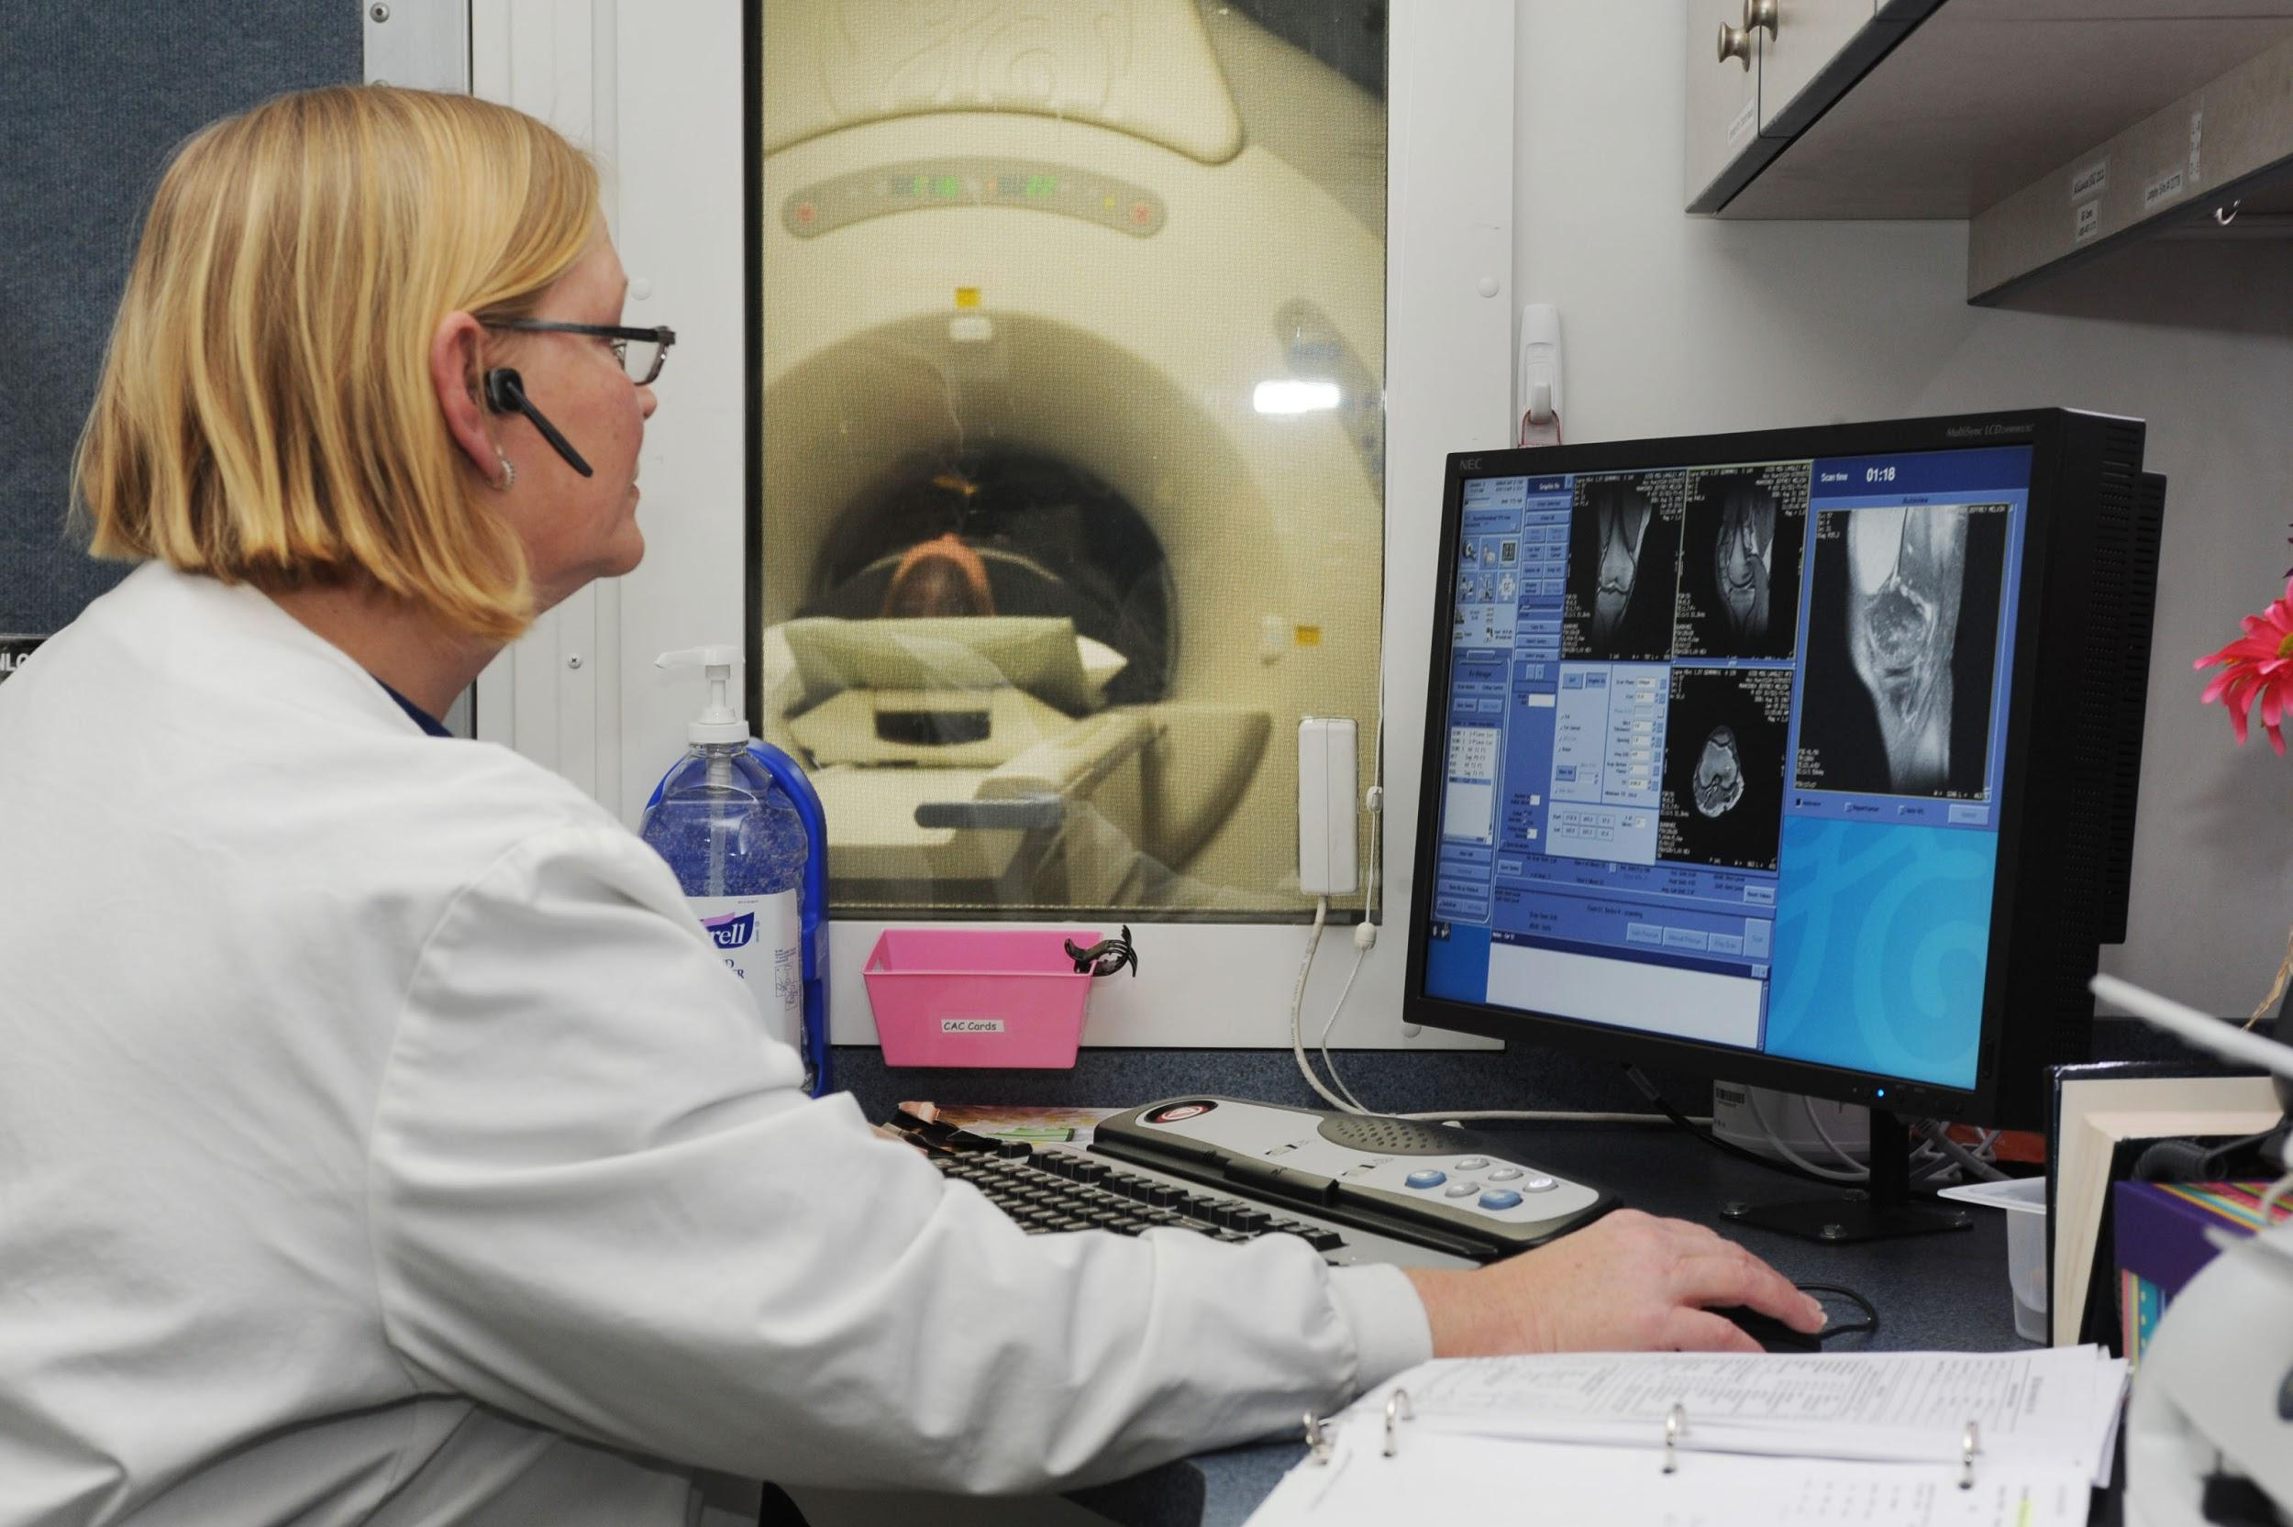
Ways of detecting this brain abnormality:
Physical-neurological tests
Blood tests
MRI,CT scans
CDR (Clinical Dementia Rating) found out using MMSE (Mini-Mental State Exam)
Loss of neurons and synapses in the cerebral cortex and certain subcortical regions
Notes:
Physical-neurological testing
Blood tests(for detecting thyroid disorders,vitamin deficiencies etc.)
Brain imaging (MRI scan | CT scan)
Fluorodeoxyglucose(FDG) PET
Amyloid PET imaging
Tau Pet Imaging

Slide 8
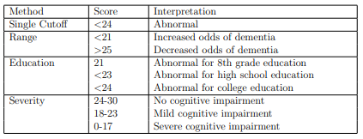
MMSE(Mini Mental State Examination):
Used for checking cognitive impairment
Used for assessing several mental abilities
Takes 5-10 mins
Maximum marks : 30
Score obtained decided percentage of cognitive impairment
Notes:
Physical-neurological testing
Blood tests(for detecting thyroid disorders,vitamin deficiencies etc.)
Brain imaging (MRI scan | CT scan)
Fluorodeoxyglucose(FDG) PET
Amyloid PET imaging
Tau Pet Imaging

Slide 9
Literature Survey(Existing Systems)
Sr. No. | Paper Name | Year of Publication | i/p & o/p | Algorithm used | Accuracy | Issues
1 | A segmentation technique to detect AD using image processing | 3-5 March 2016 | MRI scans of Brain only focussing on Hippocampus | Watershed algorithm used to identify the Hippocampus region | 87 | When there is no significant greyscale difference, it becomes difficult to get accurate segments
2 | An intelligent Alzheimer’s disease diagnosis method using unsupervised feature learning | 10 April 2019 | MRI scans of Brain (ADNI dataset) | A two-stage learning method has been used. Sparse filtering is done in the first stage and SoftMax regression is applied to the then learned features in the second stage. | 98.7% | Larger input dimension is causing to spend more time for the method
3 | Brain MRI analysis for AD diagnosis using an ensemble system of deep Convolutional Neural Networks | 31 May 2018 | MRI scans of Brain (OASIS dataset) 416 subjects aged 18-96 | Three deep convolutional neural networks (Convolution, batch normalization, rectified linear unit, pooling are the layers used) | 77% | Since the network used is a very deep NN, so without a large dataset, training process would not work correctly

Slide 10
Existing Systems
Sr. No. | Paper Name | Year of Publication | i/p & o/p | Algorithm used | Accuracy | Issues
4 | Applying Convolutional Neural Networks for Pre-detection of AD from Structural MRI data | November 2019 | MRI scans of Brain (ADNI dataset) | exp_1: Accuracy testing SVM exp_2: Application of CNN | exp_1: 84.4% exp_2: 96% | Extended ROI performance decreases as edge detection algorithm removes white and grey matter details from brain image
5 | Detection of AD from MRI using CNN with Tensorflow |  | MRI scans of Brain (OASIS and ADNI dataset) | Convolutional Neural Network (3 layered) (Convolutional layer handles image filtration, pooling layer deals with reducing sample size and controls overfitting) Tensorflow used for Data visualization as well as obtaining pre-trained model of CNN | 90% | Use of outdated APIs, expensive GPUs/Cloud instances. Efficient data wrangling was required

Slide 11
Proposed System
Using ADNI dataset
Categorizing images into 2 classes - AD and CN
Pre-processing: Image segmentation to extract grey matter
Applying Convolutional Neural Network
Training with pre-processed images
Testing with a newly pre-processed MRI scan
Get Result

Slide 12
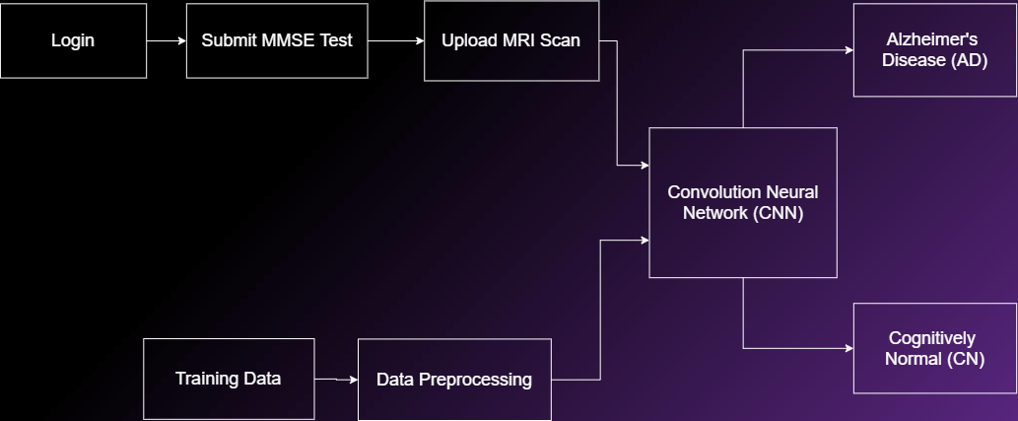
Block Diagram

Slide 13
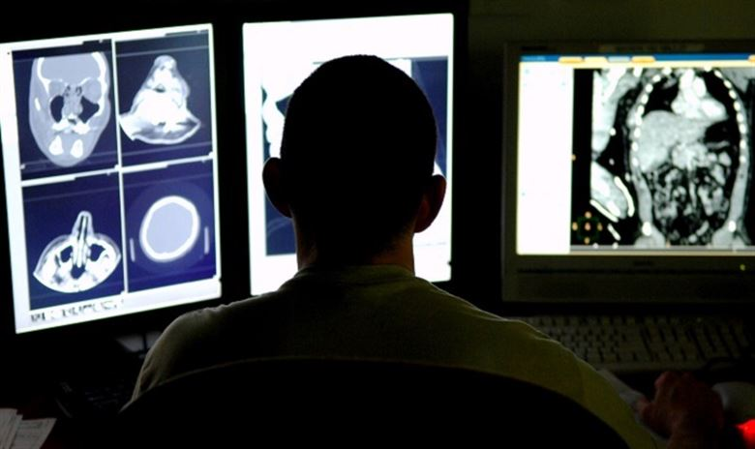
Description of Dataset
ADNI: Alzheimer’s disease Neuroimaging Initiative
Longitudinal multicenter study
Designed to develop clinical, imaging, genetic, and biochemical biomarkers
Useful for the early detection and tracking of Alzheimer’s disease (AD)

Slide 14
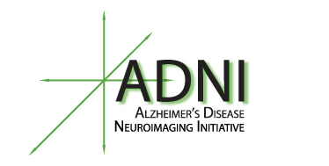
ADNI Dataset
Contains parameters: subject ID | age | gender
Different views MRI scans: Sagittal | Coronal | Axial
What we have used?
All views have been considered
Grey matter extracted from each scan

Slide 15
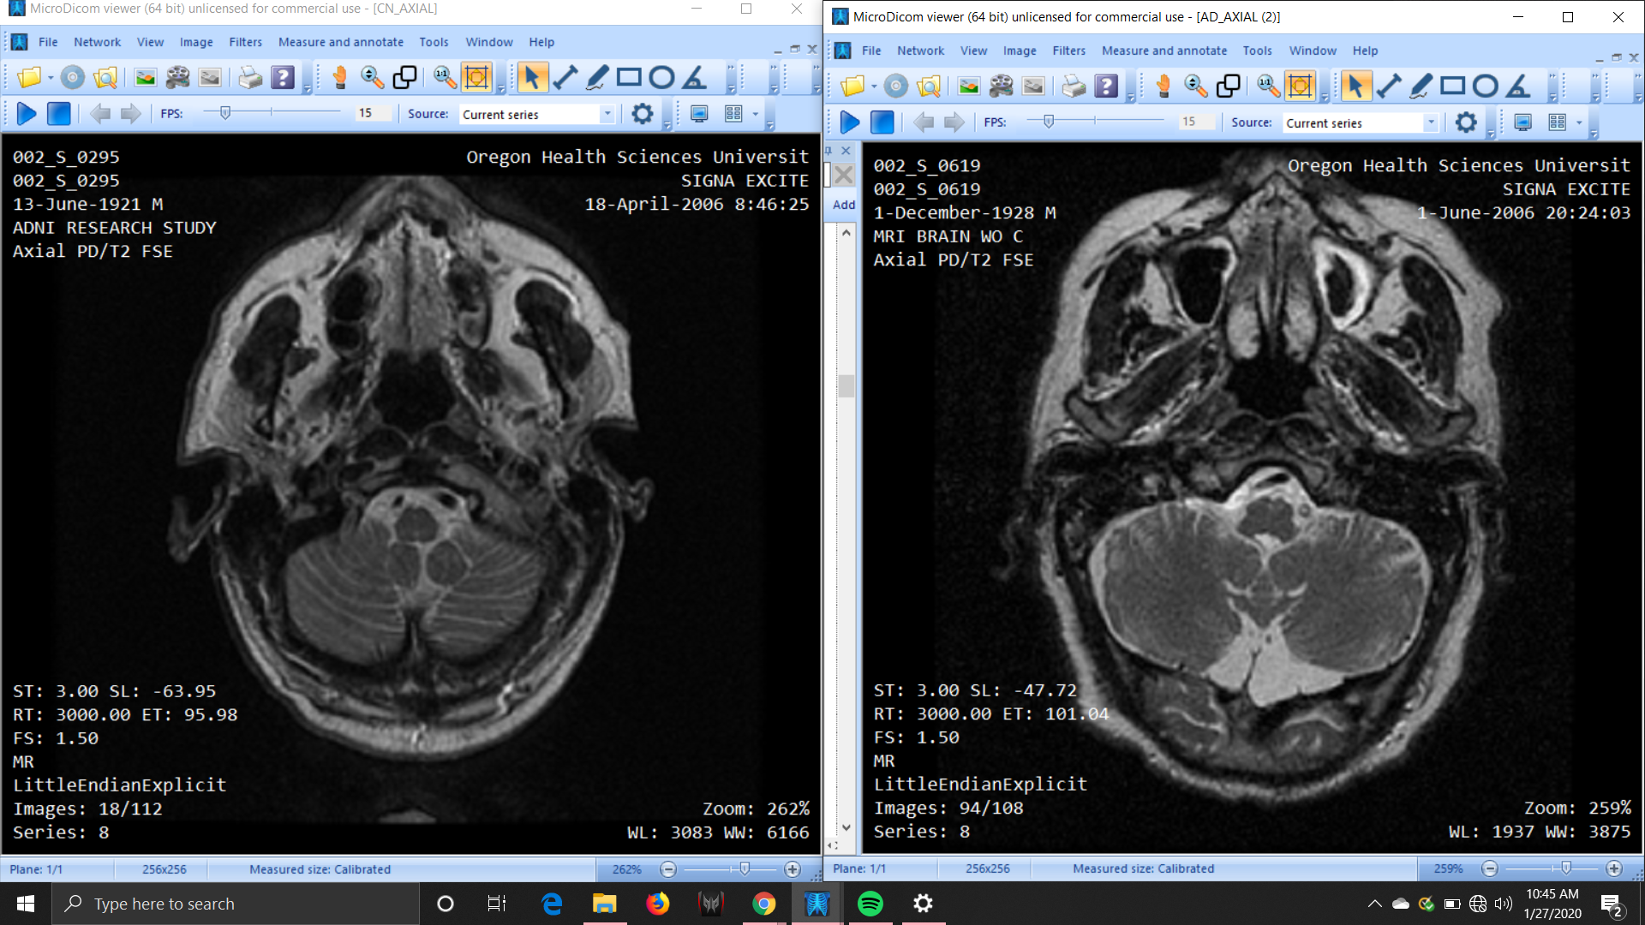
Difference between CN and AD MRI
CN AD

Slide 16
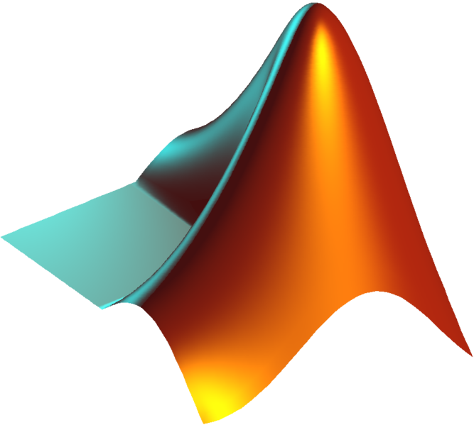
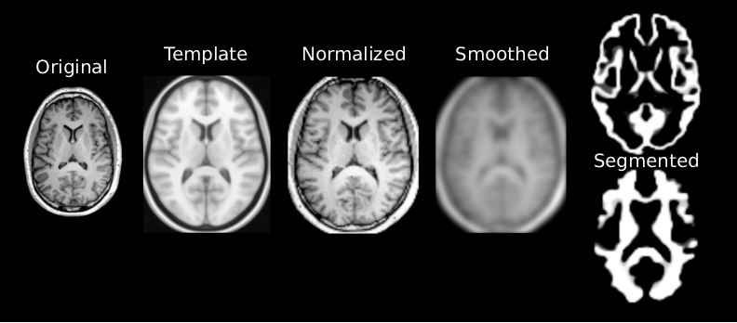
Image pre-processing
using MATLAB
Critical step
Improved data
Image segmentation

Slide 17
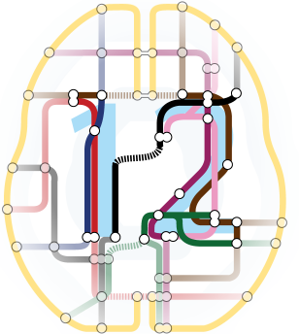
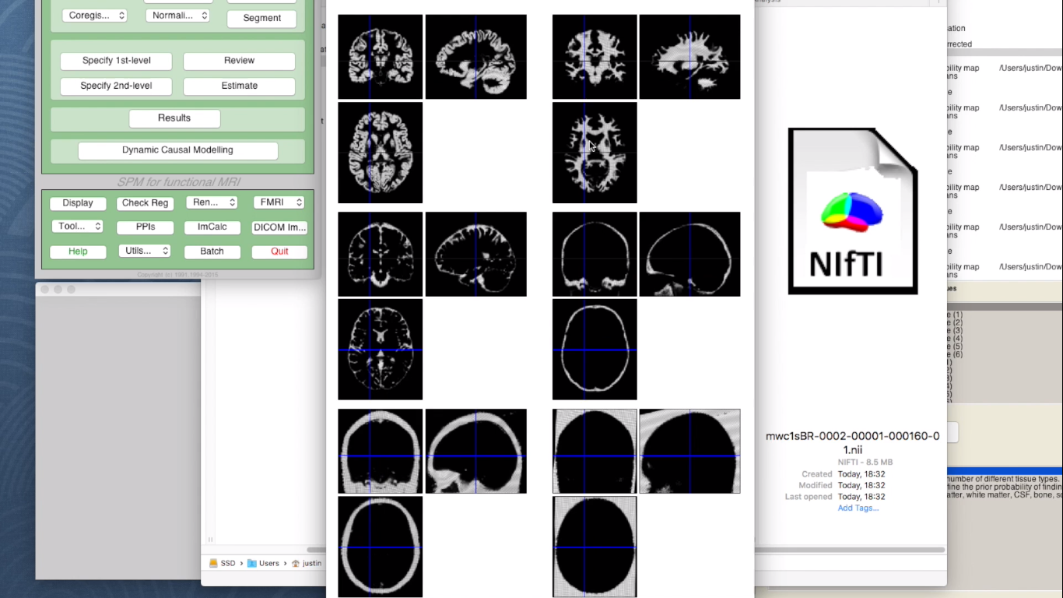
Image Segmentation
using SPM12 tool
Identifies regionally specific effects
Extracts specific tissues from brain images

Slide 18
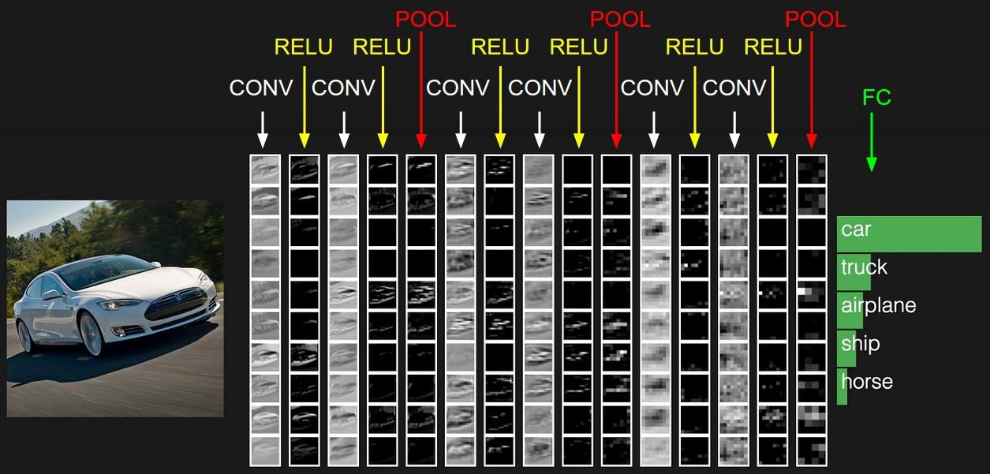
CNN Architecture

Slide 19
CNN Architecture
Convolution layer

Slide 20
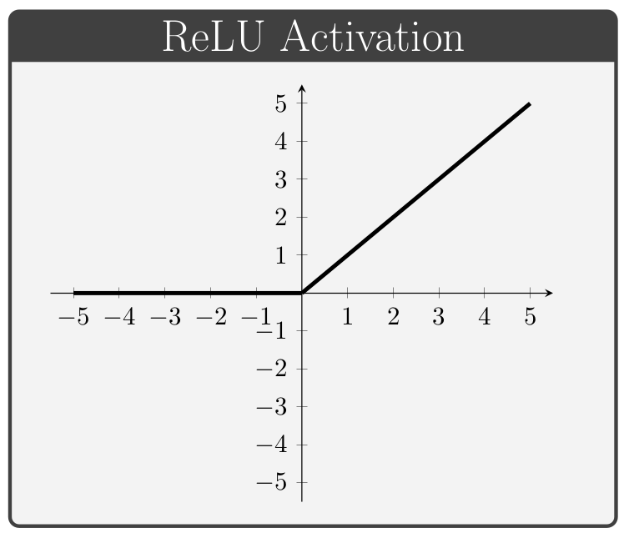
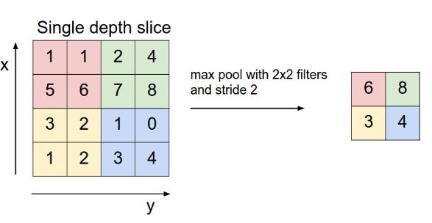
CNN Architecture
ReLU Max Pooling Layer

Slide 21
DEMO

Slide 22
Conclusion
Built a system that reduces human(Doctor) efforts
A full-fledged system that detects percentage of brain impairment in people
Conclusion & Future Scope
Future Scope
Improving accuracy
Deployment

Slide 23
Thank You

